Slide 1
AI – Prof. R.G.Mehta
Brief introduction to AI
Goal-based agents
Representing states and operators
Example problems
Generic state-space search algorithm

Slide 2
What is AI?
A branch of Science which deals with helping machines finding solutions to complex problems in a more human-like fashion.
generally involves borrowing characteristics from human intelligence, and applying them as algorithms in a computer friendly way.
generally associated with Computer Science, but it has many important links with other fields such as Maths, Psychology, Cognition, Biology and Philosophy, among many others.

Slide 3
Components of AI
Hardware
Software
Architectural

Slide 4
Hardware Components of AI
Pattern Matching
Logic Representation
Symbolic Processing
Numeric Processing
Problem Solving
Heuristic Search
Natural Language processing
Knowledge Representation
Expert System
Neural Network
Learning
Planning
Semantic Network

Slide 5
Software Components of AI
Machine Language
Assembly language
High level Language
LISP Language / PROLOG
Fourth generation Language
Object Oriented Language
Distributed Language
Natural Language
Particular Problem Solving Language

Slide 6
Architectural Components AI
Uniprocessor
Multiprocessor
Special Purpose Processor
Array Processor
Vector Processor
Parallel Processor
Distributed Processor

Slide 7
Some Definitions of AI
AI is the study of how to make computers do things which at the moment people do better. This is ephemeral as it refers to the current state of computer science and it excludes a major area ; problems that cannot be solved well either by computers or by people at the moment.
AI is a field of study that encompasses computational techniques for performing tasks that apparently require intelligence when performed by humans.
AI is the branch of computer science that is concerned with the automation of intelligent behaviour. A I is based upon the principles of computer science namely data structures used in knowledge representation, the algorithms needed to apply that knowledge and the languages and programming techniques used in their implementation.
AI is the field of study that seeks to explain and emulate intelligent behaviour in terms of computational processes.

Slide 8
Some definitions of AI
AI is about generating representations and procedures that automatically or autonomously solve problems heretofore solved by humans.
AI is the part of computer science concerned with designing intelligent computer systems, that is, computer systems that exhibit the characteristics we associate with intelligence in human behaviour such as understanding language, learning, reasoning and solving problems.
AI is the study of mental faculties through the use of computational models.
AI is the study of the computations that make it possible to perceive, reason, and act.
AI is the exciting new effort to make computers think machines with minds, in the full and literal sense.
AI is concerned with developing computer systems that can store knowledge and effectively use the knowledge to help solve problems and accomplish tasks.

Slide 9
Area of AI
Perception
Machine Vision:
interface a TV camera to a computer and get an image into memory;
Then understand the image.. What does it represent?
Vision takes lots of computation
in humans, roughly 10% of all calories consumed are burned in vision computation
Speech Understanding:
Some systems must be trained for the individual user
May require pauses between words while trainning
Understanding continuous speech with a larger vocabulary is harder.
Touch(tactile or haptic) Sensation:
Important for robot assembly tasks.

Slide 10
Areas of AI
Robotics :
Industrial robots have been expensive
Now a days economical robot hardware also available
Most important is perception and intelligence to tell the robot what to do
``blind'' robots are limited to very well-structured tasks (like spray painting car bodies).
Planning:
Planning attempts to order actions to achieve goals
Planning applications include logistics, manufacturing scheduling, planning manufacturing steps to construct a desired product.
There are huge amounts of money to be saved through better planning.

Slide 11
Areas of AI
Expert Systems
attempt to capture the knowledge of a human expert and make it available through a computer program.
Expert systems provide the following benefits
Reducing skill level needed to operate complex devices
Diagnostic advice for device repair
Interpretation of complex data
`Cloning'' of scarce expertise
Capturing knowledge of expert who is about to retire
Combining knowledge of multiple experts.

Slide 12
Areas of AI
Natural Language Processing
Natural Language Understanding
Speech Understanding
Language Generation
Machine Translation

Slide 13
Areas of AI
Game Playing
GP are good vehicles for research because they are well formalized, small, and self-contained
GP can be easily programmed
Games can be good models of competitive situations, so principles discovered in game-playing programs may be applicable to practical problems.
Others areas
Theorem proving
Symbolic mathematics

Slide 14
Knowledge in AI
AI Technique Intelligence requires knowledge but knowledge possesses less desirable properties such as
It is voluminous
it is difficult to characterise accurately
it is constantly changing
it differs from data by being organised in a way that corresponds to its application

Slide 15
Characteristics of Knowledge in AI
AI technique exploits the represented knowledge so that
The knowledge captures generalisations
situations that share properties, are grouped together, rather than being allowed separate representation.
It can be understood by people who must provide it
In many AI domains people must supply the knowledge to programs in a form the people understand and in a form that is acceptable to the program
although for many programs the bulk of the data may come automatically, such as from readings
It can be easily modified
to correct errors and reflect changes in real conditions
It can be widely used even if it is incomplete or inaccurate
It can be used to narrow the range of possibilities (knowledge) that must be usually considered from the available bulk of knowledge

Slide 16
Problem-solving in AI
The problem of AI is directly associated with the nature of humans and their activities. So we need a number of finite steps to solve a problem which makes human easy works.
These are the following steps which require to solve a problem :
Goal Formulation:
the first and simple step in problem-solving
It organizes finite steps to formulate a target/goals which require some action to achieve the goal
the formulation of the goal is based on AI agents.
Problem formulation:
It is one of the core steps of problem-solving which decides what action should be taken to achieve the formulated goal
In AI this core part is dependent upon software agent which consisted of the following components to formulate the associated problem.

Slide 17
Problem Formulation
Building a system to solve a problem requires the following steps
Define the problem precisely
including detailed specifications
Including an acceptable solution
Analyse the problem thoroughly
some features may have a dominant affect on the chosen method of solution
Isolate and represent the background knowledge needed in the solution of the problem
Choose the best problem solving techniques in the solution
A state represents a status of the solution at a given step of the problem solving procedure
The solution of a problem, thus, is a collection of the problem states.
operator is applied to current state to get the next state
The process is continued until the goal (desired) state is derived.
This Problem solving technique is referred to as state space approach

Slide 18
Problem Formulation Simple example
in order to solve play a game (e.g. two person table or board games) we need
the rules of the game
the targets for winning
means of representing positions in the game
The opening position can be defined as the initial state and a winning position as a goal state,
There can be more than one. legal moves allow for transfer from initial state to other states leading to the goal state.
Rules are far too copious in most games especially like chess and cannot in general be supplied accurately and computer programs cannot easily handle them.
The storage also presents another problem but searching can be achieved by hashing.
The number of rules that are used must be minimised and the set can be produced by expressing each rule in as general a form as possible.

Slide 19
Components of Problem Formulation
Initial State:
This state requires an initial state for the problem which starts the AI agent towards a specified goal. In this state new methods also initialize problem domain solving by a specific class.
Action:
This stage of problem formulation works with function with a specific class taken from the initial state and all possible actions done in this stage.
Transition:
This stage of problem formulation integrates the actual action done by the previous action stage and collects the final stage to forward it to their next stage.
Goal test:
This stage determines that the specified goal achieved by the integrated transition model or not, whenever the goal achieves stop the action and forward into the next stage to determines the cost to achieve the goal.
Path costing:
This component of problem-solving numerical assigned what will be the cost to achieve the goal. It requires all hardware software and human working cost.

Slide 20
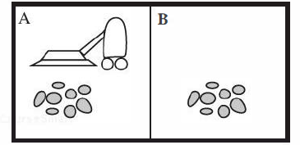
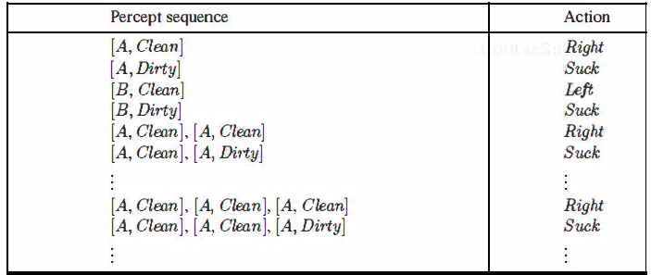
Intelligent Agents
A vacuum-cleaner world with just two locations.
Partial tabulation of a simple agent function for the vacuum-cleaner world

Slide 21
The water jug problem
Problem description:
There are two jugs called X and Y
X holds a maximum of four(4) gallons
Y holds a maximum of three (3) gallons.
Initial : Both Jugs are empty
Goal : How can we get 2 gallons in the jug X?
(2,n) where n is a don't care but is limited to X holding from 0 to 3 gallons.
[
The state space is a set of ordered pairs giving the number of gallons in the pair of jugs at any time ie (X,Y) where X= 0, 1, 2, 3, 4 and Y= 0, 1, 2, 3.
The major production rules for solving this problem are shown below:

Slide 22
State space for Water-Jug
SrNo Current State Control strategy Nest state action
1 (X,Y) if X < 4 (4,Y) fill X from tap
2 (X,Y) if Y< 3 (X,3) fill Y from tap
3 (X,Y) If X > 0 (0,Y) empty X into drain
4 (X,Y) if Y > 0 (X,0) empty Y into drain
5 (X,Y) if X+Y<4 (X+Y,0) empty Y into X
6 (X,Y) if X+Y<3 (0,X+Y) empty X into Y
7 (0,Y) If Y>0 (Y,0) empty Y into X
8 (X,0) if X>0 (0,X) empty X into Y
9 (0,2) (2,0) empty Y into X
10 (2,0) (0,2) empty X into Y
11 (X,Y) if X<4 (4,Y-diff) pour diff, 4-X, into X from Y
12 (Y,X) if Y<3 (X-diff,3) pour diff, 3-Y, into Y from X

Slide 23
State space for Water-Jug
Initial condition goal comment
1 (X,Y) if X < 4 (4,Y) fill X from tap
1.1 (1,y) (4,Y)
1.2 (2,Y) (4,Y)
1.3 (3,Y) (4,Y)
2 (X,Y) if Y< 3 (X,3) fill Y from tap
3 (X,Y) If X > 0 (0,Y) empty X into drain
3.1 (1,Y) (0,y)
3.2 (2,y) (0,Y)
3.3 (3,Y) (0,Y)
4 (X,Y) if Y > 0 (X,0) empty Y into drain
5 (X,Y) if X+Y<4 (X+Y,0) empty Y into X
6 (X,Y) if X+Y<3 (0,X+Y) empty X into Y
7 (0,Y) If Y>0 (Y,0) empty Y into X
8 (X,0) if X>0 (0,X) empty X into Y
9 (0,2) (2,0) empty Y into X
10 (2,0) (0,2) empty X into Y
11 (X,Y) if X<4 (4,Y-diff) pour diff, 4-X, into X from Y
12 (Y,X) if Y<3 (X-diff,3) pour diff, 3-Y, into Y from X

Slide 24
State space for Water-Jug
Initial condition goal comment
1 (X,Y) if X < 4 (4,Y) fill X from tap
2 (X,Y) if Y< 3 (X,3) fill Y from tap
3 (X,Y) If X > 0 (0,Y) empty X into drain
4 (X,Y) if Y > 0 (X,0) empty Y into drain
5 (X,Y) if X+Y<4 (X+Y,0) empty Y into X
6 (X,Y) if X+Y<3 (0,X+Y) empty X into Y
7 (0,Y) If Y>0 (Y,0) empty Y into X
8 (X,0) if X>0 (0,X) empty X into Y
9 (0,2) (2,0) empty Y into X
10 (2,0) (0,2) empty X into Y
11 (X,Y) if X<4 (4,Y-diff) pour diff, 4-X, into X from Y
12 (Y,X) if Y<3 (X-diff,3) pour diff, 3-Y, into Y from X
Solution
X Y Rule
0 0
0 3 2
3 0 7
3 3 2
4 2 11
0 2 3
2 0 10

Slide 25
Control strategies
Characteristics of a good control strategy
It must causes motion.
In a game playing program the pieces move on the board and in the water jug problem water is used to fill jugs.
it must be systematic
it would not be sensible
to fill a jug and empty it repeatedly
to move a piece round and round the board in a cyclic way.
Systematic approaches of searching

Slide 26
PROBLEM CHARACTERISTICS
The problem may have different type of representation and explanation
Key dimensions of the problems are:
Is the problem decomposable into set of sub problems?
Can the solution step ignorable / recoverable or non-recoverable?
Is the problem universally predictable?
Is a good solution to the problem obvious without comparison to all the possible solutions?
Is the desire solution a state of world or a path to a state?
Is a large amount of knowledge absolutely required to solve the problem?
Will the solution of the problem required interaction between the computer and the person?
The above characteristics of a problem are called as 7-problem characteristics under which the solution must take place.

Slide 27
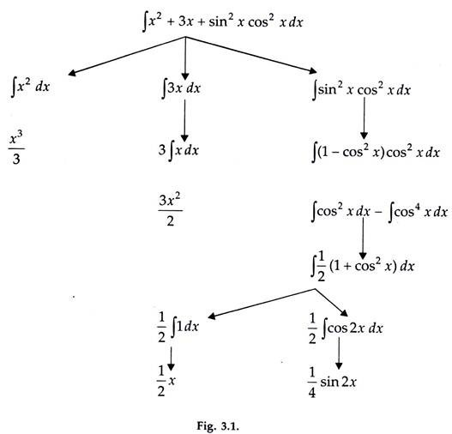
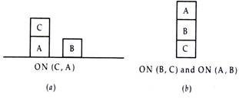
Decomposable vs Non-decomposable
1. Is the problem Decomposable? By this method we can solve large problem easily. Ex: Decomposable problem Symbolic Integration ∫ (x2 +3x + Sin2x.Cos2x )dx Can be divided to Integral of x2 Integral of 3x Integral of Sin2x.Cos2x, which can be further divided to (1- Cos2x). Cos2x ….
4 1. Is the problem Decomposable? Ex: Non- decomposable problemsBlock World ProblemAssume that only two operations are available:CLEAR(x)[Block x has nothing on it]->ON(x,Table)[Pick up x and put on the table]Clear(x) and Clear(y)->ON(x,y)[Put x on y]ON(B,C) and ON(A,B)
Is the problem Decomposable?

Slide 28
Ignorable or Recoverable
Ignorable problem:
solution steps can be ignored
Theorem Proving :
E.g.
We proceed by first proving a lemma that we think will be useful.
Eventually, we realize that the lemma is not help at all.Every thing we need to know to prove theorem is still true and in memory, if it ever was.
Any rule that could have been applied at the outset can still be applied. All we have lost is the effort that was spent exploring the blind alley.

Slide 29
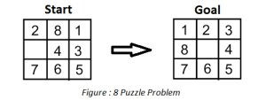
Ignorable or Recoverable
Recoverable problem:
in which solution steps can be undone.
Ex:- The 8-Puzzle
While attempting to solve the 8-puzzle problem, mistakenly we make a wrong move and realize that mistake
Now to correct our mistake we need to undo incorrect steps
To undo incorrect steps the control mechanism must keep track of the order in which steps are performed, so that we can backtrack to the initial state and start with some correct move.

Slide 30
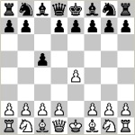
Recoverable vs Irrecoverable
Solution steps cannot be undone. (e.g., Chess).
a wrong move is realized after couple of moves, cannot simply be ignored or undone.
Here, once we make a move we never recover from that step. Only we can try to give the best of the current situation.

Slide 31
Predictable or Non-Predictable Universe
Predictable problem (8-Puzzle)
Every time we make a move, we know exactly what will happen.
possible to plan entire sequence of moves and
Surety of the resulting state will be.
Uncertain-outcome problem(play Bridge)
One of the decisions we will have to make is which card to play on the first trick.
What we would like to do is to plan entire hand before making the 1st hand.
But now it is not possible to do such planning with certainty since we cannot know exactly where all the cards are or what the other players will do on their turn.

Slide 32
Absolute or Relative Solution
Any-path problem (Answer-question System0
Consider the problem of answering the question based on following facts:
Marcus was a man.
Marcus was a Pompean.
Marcus was born in 40 AD.
All men are mortal.
All Pompeans died when volcano erupted in 79 AD.
No mortal lives longer than 150 years.
Now it is 1991 AD.
Question : “ Is Marcus alive?”
Marcus was a man - Axiom1
All men are mortal -Axiom4
Marcus is Mortal – 1,4
Marcus was born in 40 AD -Axiom3
Now it is 1991 AD -Axiom7
Marcus age is 1951 years – 3,7
No mortal lives longer than 150 years -Axiom6
Marcus is dead -6,8,9
goal is to answer to question,
it does not matter which path we follow

Slide 33
Absolute or Relative Solution
Best-path problem
Ex: Traveling Salesman Problem
Given a road map of n cities, find the shortest tour which visits every city on the map exactly once and then return to the original city
Best-path problems are, in general, computationally harder than any-path problems.
heuristic that choose the best solution should be used
much more exhaustive search will be performed
Any-path problems
can often be solved in a reasonable amount of time by using heuristics that suggest good paths to explore.
If the heuristics are not perfect, the search for a solution may not be as optimum as possible (but that does not matter)

Slide 34
Solution as State or Path
Solution as Path
Ex: Water jug problem
Here is not sufficient to report that we have solved the problem and the final state is (2,0).
Here we must report is not the final state but the path that we found to that state.
Thus a statement of solution to this problem must be a sequence of operations (some time called apian) that produce the final state.
Solution is a state of world
Ex: Natural language understanding
To solve the problem of finding the interpretation we need to produce interpretation itself.
No record of processing by which the interpretation was found is necessary.

Slide 35
Role of Knowledge
Knowledge is important only to constrain the search for solution
Knowledge is required even to be able to recognize a solution

Slide 36
Knowledge to constrain the search for solution
Ex: playing chess
Suppose you have ultimate computing power available. How much knowledge would be required by a perfect program?
just the rule for determining legal moves and some simple control mechanism that implement an appropriate search procedure
Tic-ta-Toe game
Chess
8 puzzle

Slide 37
Knowledge to recognize a solution
Example:
Scanning daily news paper to decide which group of the community is supporting the democrats and which are supporting the republicans in upcoming elections
The knowledge contain
The name of candidates in each party
The knowledge abut people
The knowledge must be able to identify
Supporters of republicans…. Check for people who have lowered taxes
Supporters of democrats….. check for minority students with improved education
And so on......

Slide 38
Interactive Task
Non interactive
the computer is given a problem description and produces an answer
no intermediate communication
no demand for an explanation for the process.
Interactive
Level of interaction b/w computer and user is problem-in solution-out.
EX: Theorem Proving Conversational
there is intermediate communication between a person and the computer, either to provide additional assistance to computer
Ex.: Medical diagnosis
provide additional information to user and computer both.

Slide 39
Some Game Problems

Slide 40
Water Jug Problem
Given a full 5-gallon jug and an empty 2-gallon jug, the goal is to fill the 2-gallon jug with exactly one gallon of water.
Operator table
Name | Con d. | Transition | Effect
Empty5 | – | (x,y)→(0,y) | Empty 5-gal. jug
Empty2 | – | (x,y)→(x,0) | Empty 2-gal. jug
2to5 | x ≤ 3 | (x,2)→(x +2,0) | Pour 2-gal. into 5-gal.
5to2 | x ≥ 2 | (x, 0)→(x-2,2) | Pour 5-gal. into 2-gal.
5to2part | y < 2 | (1,y)→(0,y +1) | Pour partial 5- gal. into 2-gal.
State = (x,y), where x is the number of gallons of water in the 5-gallon jug and y is # of gallons in the 2-gallon jug
Initial State = (5,0)
Goal State = (*,1), where
* means any amount

Slide 41
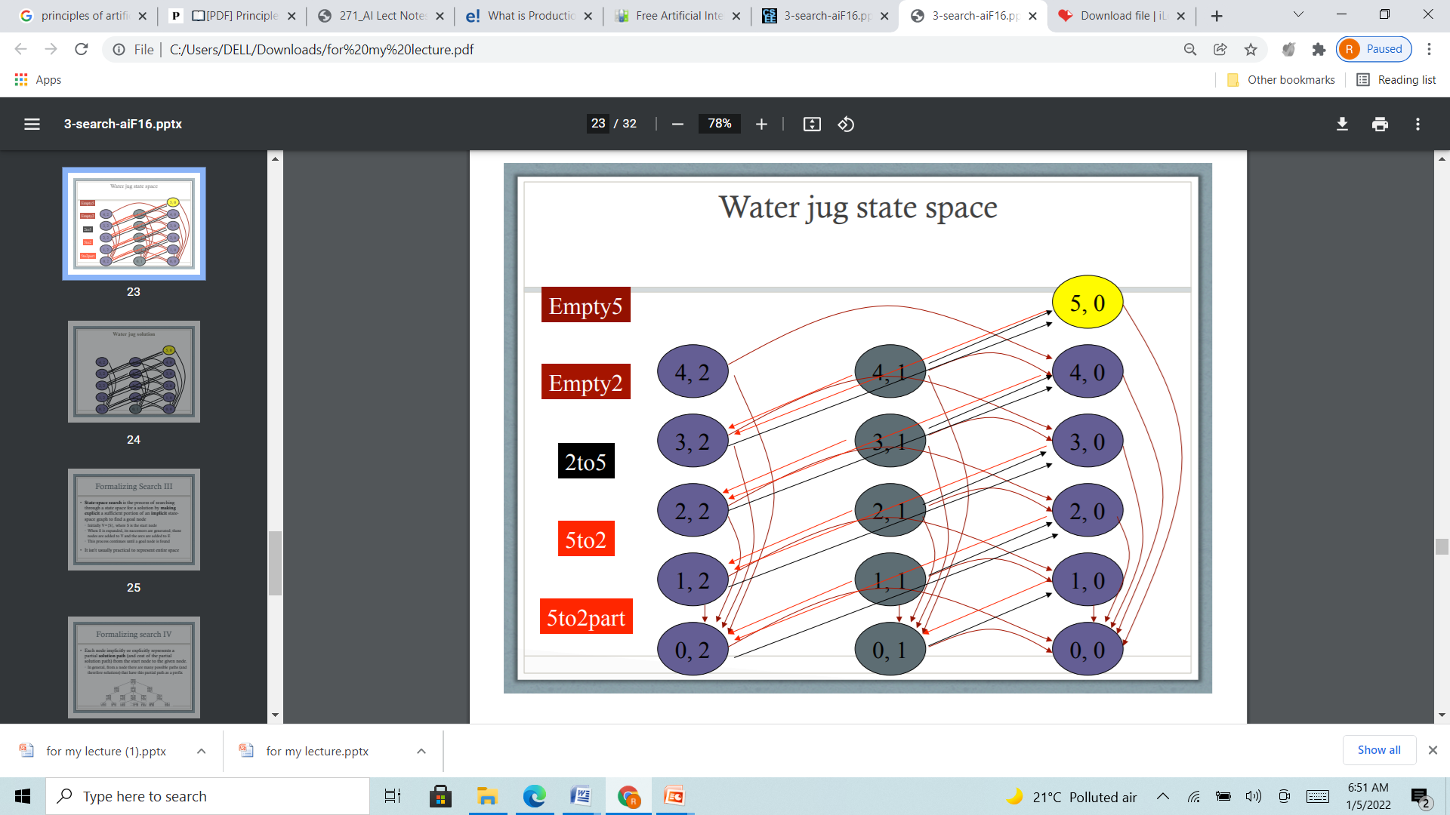
Water Jug Problem state Space(Graph)

Slide 42
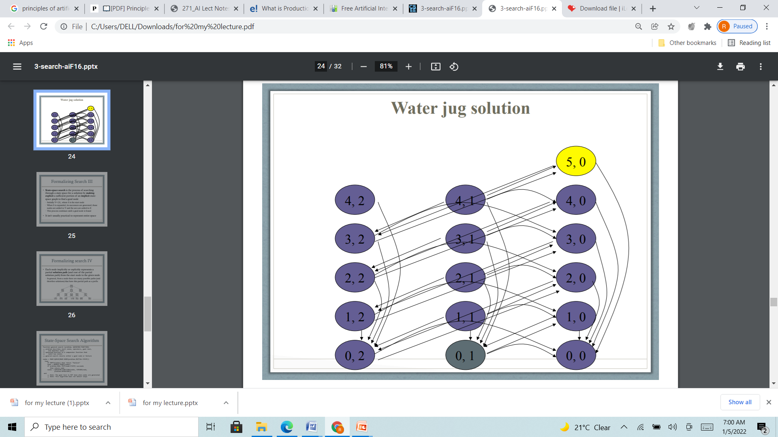

Slide 43
Water Jug Rpblem (Tree structure)
Rule set:
(x,y)->(4,y) fill the 4 gallon jug If x<4
(x,y)->(x,3) fill the 3 gallon jug If x<3
(x,y)->(x-d,y) pour some water out of the 4-gallon jug.If x>0 (x,y)->(x-d,y)
pour some water out of the 3-gallon jug.If y>0
(x,y)->(0,y) empty the 4-gallon jug on the ground If x>0
(x,y)->(x,0) empty the 3-gallon jug on the ground If y>0
(x,y)->(4,y-(4-x)) pour water from the 3-gallon jug into the 4-gallon If x+y>=4 and y>0 jug until the 4-gallon jug is full
(x,y)->(x-(3-y),3)) pour water from the 4-gallon jug into the 3-gallon If x+y>=3 and x>0 jug until the 3-gallon jug is full.
(x,y)->(x+y,0) pour all the water from the 3-gallon jug into If x+y<=4 and y>0 the 3-gallon jug.
(x,y)->(0,x+y) pour all the water from the 4-gallon jug into If x+y<=3 and x>0 the 3-gallon jug.
(0,2)->(2,0) pour the 2-gallon from the 3-gallon jug into the 4-gallon jug.
(2,y)->(0,x) empty the 2 gallon in the 4 gallon on the ground

Slide 44
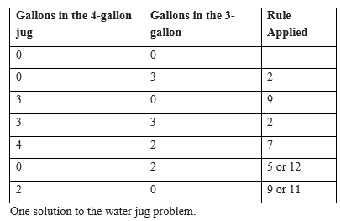
Production of the Water Jug Problem

Slide 45
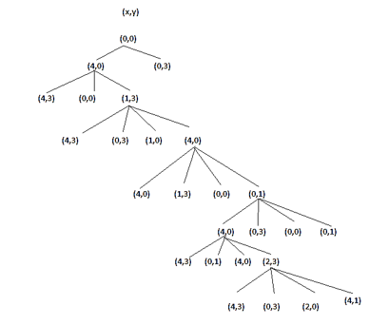
Search in the statespace

Slide 46
8 Puzzle problem
The program is to change the initial configuration into the goal configuration.
A solution to the problem is an appropriate sequence of moves, such as “move tile 5 to the right, move tile 7 to the left, move tile 6 to the down” etc…
To solve a problem, we must specify the
Global database(Problem staes)
Rules(Moves and control strategy )
Goal
In this problem each tile configuration is a state.
The set of all possible configuration in the problem space, consists of 3,62,880 different configurations of the 8 tiles and blank space.
For the 8-puzzle, a straight forward description is a 3X3 array of matrix of numbers.

Slide 47
8 puzzle problem
The 8-puzzle is conveniently interpreted as having the following moves
Move empty space (blank) to the left, move blank up, move blank to the right and move blank down.
These moves are modeled by production rules that operate on the state descriptions in the appropriate manner
The goal condition forms the basis for the termination.
The control strategy repeatedly applies rules to state descriptions until a description of a goal state is produced.
It also keeps track of rules that have been applied so that it can compose them into sequence representing the problem solution.

Slide 48
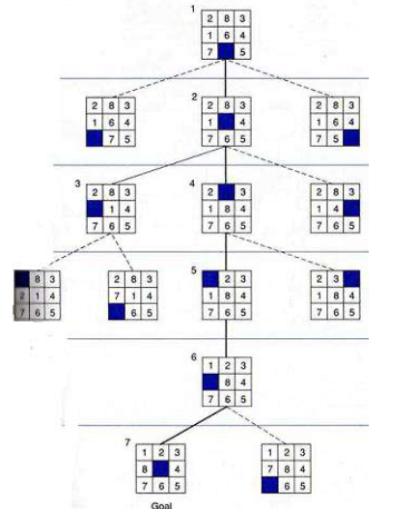
8 puzzle game
Sample Solution

Slide 49
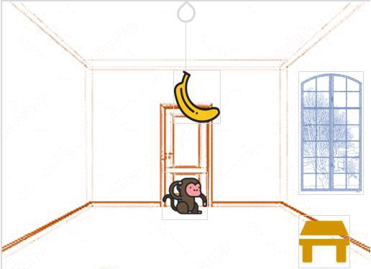
Monkey banana Problem
Problem Statement
A hungry monkey is in a room, and he is near the door
The monkey is on the floor
Banana is hung from the center of the ceiling of the room
There is a block (or chair) present in the room near the window
The monkey wants the banana, but cannot reach it

Slide 50
The Monkey Banana Problem
Strategy
Monkey can come to the block, drag the block to the center, climb on it, and get the banana.
Below are few observations in this case −
Monkey can reach the block, if both of them are at the same level.
From the above image, we can see that both the monkey and the block are on the floor.
If the block position is not at the center, then monkey can drag it to the center.
If monkey and the block both are on the floor, and block is at the center, then the monkey can climb up on the block.
So the vertical position of the monkey will be changed.
When the monkey is on the block, and block is at the center, then the monkey can get the bananas.

Slide 51
The Monkey Banana Problem (State Desccription)
Initial State
Monkey is on the ground
Monkey is Not in the Center
Box is on the ground
Box is not in the center
State (0,P1,0,P2)
Goal State
Monkey is on the Box
Box is in the center
Monkey has banana
Action
Monkey Walk to the Box
Monkey drag the box from Position1 to Center
Monkey Climb the Box
Monkey has banana

Slide 52
The Monkey Banana Problem (State Description)
Sate() as a predicate
Monkey Position in the room (Middle, or not )
Monkey Position related to box (On the Box or not)
Box Position (Middle, or not)
Banana status (has, or hasnot)
E.g. state(MIDDLE,1,MIDDLE,0,hasnot)
Grasp() as a predicate
E.g. grasp(stae(stae(middle,onbox,middle,hasnot),stae(middle,onbox,middle,has))

Slide 53
Prolog Predicates to the Monkey Banana Problem
Here Four different moves are defined with Single predicate “move”
state(middle,onbox,middle,hasnot)
state(middle,onbox,middle,has)
move(state(middle,onbox,middle,hasnot), grasp, state(middle,onbox,middle,has))
move(state(P,onfloor,P,H), climb, state(P,onbox,P,H)).
move(state(P1,onfloor,P1,H), drag(P1,P2), state(P2,onfloor,P2,H)).
move(state(P1,onfloor,B,H), walk(P1,P2), state(P2,onfloor,B,H)).
canget(state(_,_,_,has)).
canget(State1) :- move(State1,_,State2), canget(State2).

Slide 54
Monkey banana Problem : 2
A monkey is in a cage and bananas are suspended from the ceiling, the monkey wants to eat a banana but cannot reach them
in the room are a chair and a stick
if the monkey stands on the chair and waves the stick, he can knock a banana down to eat it
what are the actions the monkey should take?
Initial state:
monkey on ground
with empty hand
bananas suspended
Goal state:
monkey eating
Actions:
climb chair/get off
grab X
wave X
eat X

Slide 55
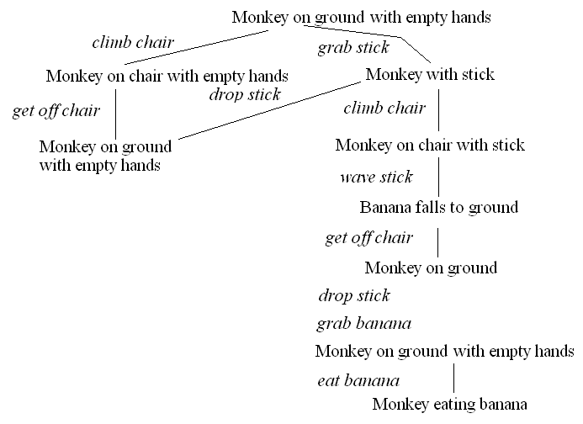
Monkey banana Problem : 2(Search Space)
Define state space (HW)

Slide 56
Missionaries and Cannibals
3 missionaries and 3 cannibals are on one side of the river with a boat that can take exactly 2 people across the river
how can we move the 3 missionaries and 3 cannibals across the river
with the constraint that
the cannibals never outnumber the missionaries on either side of the river (lest the cannibals start eating the missionaries!)??
a boat that can take exactly 2 people across the river

Slide 57
Missionaries and Cannibals(strategy 1)
We can represent a state as a 6-item tuple:
(a, b, c, d, e, f)
a/b = number of missionaries/cannibals on left shore
c/d = number of missionaries/cannibals in boat
e/f = number of missionaries/cannibals on right shore
where a + b + c + d + e + f = 6 and c + d <= 2, c + d >= 1 to move the boat
a >= b unless a = 0, c >= d unless c = 0, e >= f unless e = 0

Slide 58
Missionaries and Cannibals
Legal operations (moves) are
0, 1, 2 missionaries get into boat (c + d must be <= 2)
0, 1, 2 missionaries get out of boat
0, 1, 2 cannibals get into boat (c + d must be <= 2)
0, 1, 2 missionaries get out of boat
boat sails from left shore to right shore (c + d must be >= 1)
boat sails from right shore to left shore (c + d must be >= 1)
drawing the state space will be left as a homework problem

Slide 59
Missionaries and Cannibals (Strategy 2)
Objects of the State World:
M M M C C C B
3 missionaries, 3 cannibals, 1 boat, a left river bank, and a right river bank.
C represents a cannibal, M represents a missionary, and B represents the location of the boat
Representation of a State of the World:
L<M C B>
R<M C B>
A state of the world is represented as 2 lists :
L is the left bank.
R is the right bank.
C represents the location’s amount of cannibals.
M represents the location's amount of missionaries.
B is 1 when the boat is on the shore and 0 when it is on the opposite shore.

Slide 60
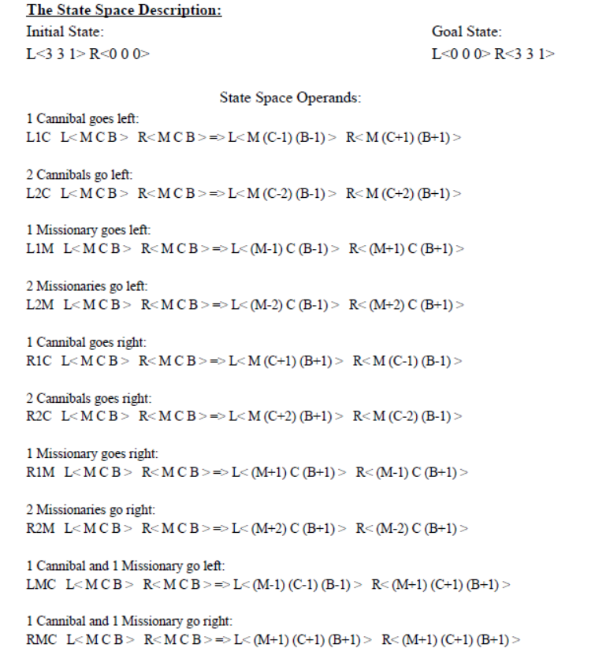
The state space

Slide 61
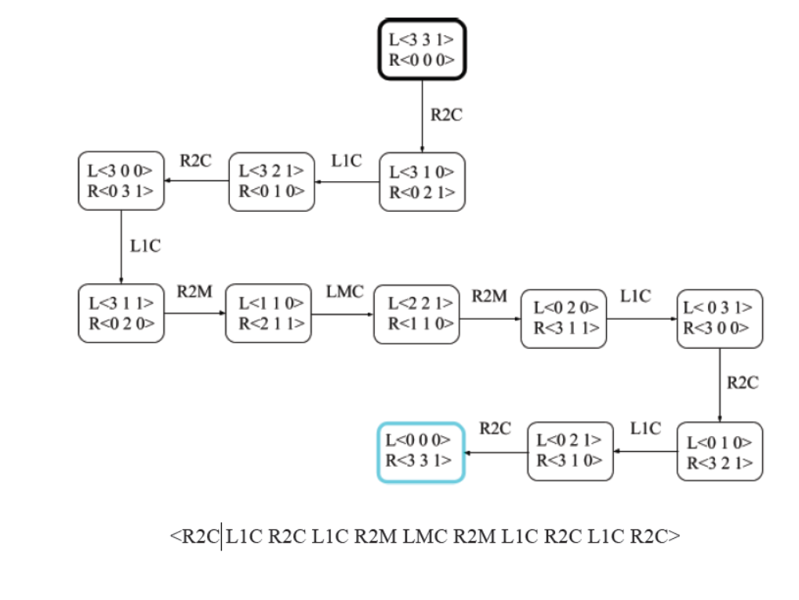
State Space Graph (Including At Least One Solution):

Slide 62
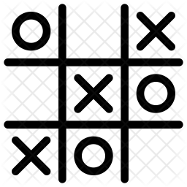
Tic Tac Toe(Board Game)
consists of a nine element vector called BOARD
it represents the numbers 1 to 9 in three rows
An element contains the value 0 for blank, 1 for X and 2 for O.
A MOVETABLE vector consists of 19,683 elements (3⁹ ) and is needed where each element is a nine element vector.
The contents of the vector are especially chosen to help the algorithm.
Index Current Board position New Board position
0 000000000 000010000
1 000000001 020000001
2 000000002 000100002
3 000000010 002000010
:
:

Slide 63
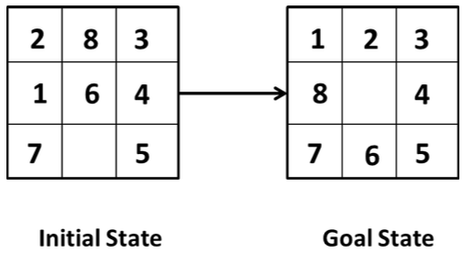
8 Puzzle problem
consists of eight numbered, movable tiles set in a 3x3 frame
One cell of the frame is always empty thus making it possible to move an adjacent numbered tile into the empty cell

Slide 64
Chess
To build a program that could play chess, we have to specify:
The starting position of the chess board
The starting position can be described by an 8 X 8 array square in which each element square (X, Y), (x varying from 1 to 8 & y varying from 1 to 8) describes the board position of an appropriate piece in the official chess opening position.
The rules that define legal moves
The legal moves provide the way of getting from initial state of final state.
The legal moves can be described as a set of rules consisting of two parts: A left side that gives the current position and the right side that describes the change to be made to the board position.
The board position that represent a win.
The goal is any board position in which the opponent does not have a legal move and his or her “king” is under attack.

Slide 65
Chess
An example
Current Position: While pawn at square ( 5, 2 ), AND Square ( 5, 3 ) is empty, AND Square ( 5, 4 ) is empty.
Changing Board Position: Move pawn from Square ( 5, 2 ) to Square ( 5, 4 ).
The current position of a chess coin on the board is its state and the set of all possible states is state space.
State space representation seems natural for playing chess problem because the set of states, which corresponds to the set of board positions, is well organised.
One or more states where the problem terminates are goal states.
Chess has approximately 10¹²⁰ game paths. These positions comprise the problem search space.
Using above formulation, the problem of playing chess is defined as a problem of moving around in a state space, where each state corresponds to a legal position of the board

Slide 66
Types of Environmnt in AI
An environment in artificial intelligence is the surrounding of the agent. The agent takes input from the environment through sensors and delivers the output to the environment through actuators. There are several types of environments: Fully Observable vs Partially Observable Deterministic vs Stochastic Competitive vs Collaborative Single-agent vs Multi-agent Static vs Dynamic Discrete vs Continuous

Slide 67
Fully Observable vs Partially Observable
When an agent sensor is capable to sense or access the complete state of an agent at each point in time, it is said to be a fully observable environment else it is partially observable. Maintaining a fully observable environment is easy as there is no need to keep track of the history of the surrounding. An environment is called unobservable when the agent has no sensors in all environments. Example: Chess – the board is fully observable, so are the opponent’s moves Driving – the environment is partially observable because what’s around the corner is not know.

Slide 68
Deterministic vs Stochastic
When a uniqueness in the agent’s current state completely determines the next state of the agent, the environment is said to be deterministic. The stochastic environment is random in nature which is not unique and cannot be completely determined by the agent. Example: Chess – there would be only a few possible moves for a coin at the current state and these moves can be determined Self Driving Cars – the actions of a self-driving car are not unique, it varies time to time

Slide 69
Competitive vs Collaborative
An agent is said to be in a competitive environment when it competes against another agent to optimize the output. The game of chess is competitive as the agents compete with each other to win the game which is the output. An agent is said to be in a collaborative environment when multiple agents cooperate to produce the desired output. When multiple self-driving cars are found on the roads, they cooperate with each other to avoid collisions and reach their destination which is the output desired.

Slide 70
Single-agent vs Multi-agent
An environment consisting of only one agent is said to be a single-agent environment. A person left alone in a maze is an example of the single-agent system. An environment involving more than one agent is a multi-agent environment. The game of football is multi-agent as it involves 11 players in each team.

Slide 71
Static vs Dynamic
An environment that keeps constantly changing itself when the agent is up with some action is said to be dynamic. A roller coaster ride is dynamic as it is set in motion and the environment keeps changing every instant. An idle environment with no change in its state is called a static environment. An empty house is static as there’s no change in the surroundings when an agent enters.

Slide 72
Discrete vs Continuous
If an environment consists of a finite number of actions that can be deliberated in the environment to obtain the output, it is said to be a discrete environment. The game of chess is discrete as it has only a finite number of moves. The number of moves might vary with every game, but still, it’s finite. The environment in which the actions performed cannot be numbered ie. is not discrete, is said to be continuous. Self-driving cars are an example of continuous environments as their actions are driving, parking, etc. which cannot be numbered.

Slide 73
Tic–Tac–Toe game playing
Two players
human
computer.
The objective is to write a computer program in such a way that computer wins most of the time.
Three approaches are presented to play this game which increase in
Complexity
Use of generalization
Clarity of their knowledge
Extensibility of their approach
These approaches will move towards being representations of what we will call AI techniques.

Slide 74
Tic Tac Toe Board- (or Noughts and crosses, Xs and Os)
It is two players, X and O, game who take turns marking the spaces in a 3×3 grid. The player who succeeds in placing three respective marks in a horizontal, vertical, or diagonal row wins the game.
1
2
3
4
5
6
positions
7
8
9

Slide 75
Approach 1
Data Structure
Consider a Board having nine elements vector.
Each element will contain
0 for blank
1 indicating X player move
2 indicating O player move
Computer may play as X or O player.
First player who so ever is always plays X.

Slide 76
Move Table MT
MT is a vector of 3⁹ elements, each element of which is a nine element vector representing board position.
Total of 3⁹ (19683) elements in MT
Index Current Board position New Board position
0 000000000 000010000
1 000000001 020000001
2 000000002 000100002
3 000000010 002000010
:
:

Slide 77
Algorithm
To make a move, do the following:
View the vector (board) as a ternary number and convert it to its corresponding decimal number.
Use the computed number as an index into the MT and access the vector stored there.
The selected vector represents the way the board will look after the move.
Set board equal to that vector.

Slide 78
Comments
Very efficient in terms of time but has several disadvantages.
Lot of space to store the move table.
Lot of work to specify all the entries in move table.
Highly error prone as the data is voluminous.
Poor extensibility
3D tic-tac-toe = 3²⁷ board position to be stored.
Not intelligent at all.

Slide 79
Approach 2
Data Structure
Board: A nine-element vector representing the board: B[1..9]
Following conventions are used
2 - indicates blank
3 - X
5 - 0
Turn: An integer
1 - First move
9 - Last move

Slide 80
Procedures Used
Make_2 → Tries to make valid 2
Make_2 first tries to play in the center if free and returns 5 (square number).
If not possible, then it tries the various suitable non corner square and returns square number.
Go(n) ← makes a move in square ‘n’ which is blank represented by 2.

Slide 81
Procedure - PossWin
PossWin (P) → Returns
0, if player P cannot win in its next move,
otherwise the number of square that constitutes a winning move for P.
Rule
If PossWin (P) = 0 {P can not win} then find whether opponent can win. If so, then block it.

Slide 82
Strategy used by PosWin
PosWin checks one at a time, for each rows /columns and diagonals as follows.
If 3 * 3 * 2 = 18 then player X can win
else if 5 * 5 * 2 = 50 then player O can win
These procedures are used in the algorithm on the next slide.

Slide 83
Algorithm
Assumptions
The first player always uses symbol X.
There are in all 8 moves in the worst case.
Computer is represented by C and Human is represented by H.
Convention used in algorithm on next slide
If C plays first (Computer plays X, Human plays O) - Odd moves
If H plays first (Human plays X, Computer plays O) - Even moves
For the sake of clarity, we use C and H.

Slide 84
Algo - Computer plays first – C plays odd moves
Move 1: Go (5)
Move 2: H plays
Move 3: If B[9] is blank, then Go(9) else Go(3) {make 2}
Move 4: H plays
Move 5: {By now computer has played 2 chances}
If PossWin(C) then {won} Go(PossWin(C))
else {block H} if PossWin(H) then Go(PossWin(H)) else if B[7] is blank then Go(7) else Go(3)
Move 6: H plays
Moves 7 & 9 :
If PossWin(C) then {won} Go(PossWin(C))
else {block H} if PossWin(H) then Go(PossWin(H)) else Go(Anywhere)
Move 8: H plays

Slide 85
Algo - Human plays first – C plays even moves
Move 1: H plays
Move 2: If B[5] is blank, then Go(5) else Go(1)
Move 3: H plays
Move 4: {By now H has played 2 chances}
If PossWin(H) then {block H} Go (PossWin(H))
else Go (Make_2)
Move 5: H plays
Move 6: {By now both have played 2 chances}
If PossWin(C) then {won} Go(PossWin(C))
else {block H} if PossWin(H) then Go(PossWin(H)) else Go(Make_2)
Moves 7 & 9 : H plays
Move 8: {By now computer has played 3 chances}
If PossWin(C) then {won} Go(PossWin(C))
else {block H} if PossWin(H) then Go(PossWin(H)) else Go(Anywhere)

Slide 86
Complete Algorithm – Odd moves or even moves for C playing first or second
Move 1: go (5)
Move 2: If B[5] is blank, then Go(5) else Go(1)
Move 3: If B[9] is blank, then Go(9) else Go(3) {make 2}
Move 4: {By now human (playing X) has played 2 chances} If PossWin(X) then {block H} Go (PossWin(X)) else Go (Make_2)
Move 5: {By now computer has played 2 chances} If PossWin(X) then {won} Go(PossWin(X)) else {block H} if PossWin(O) then Go(PossWin(O)) else if B[7] is blank then Go(7) else Go(3)
Move 6: {By now both have played 2 chances} If PossWin(O) then {won} Go(PossWin(O)) else {block H} if PossWin(X) then Go(PossWin(X)) else Go(Make_2)
Moves 7 & 9 : {By now human (playing O) has played 3 chances} If PossWin(X) then {won} Go(PossWin(X)) else {block H} if PossWin(O) then Go(PossWin(O)) else Go(Anywhere)
Move 8: {By now computer has played 3 chances} If PossWin(O) then {won} Go(PossWin(O)) else {block H} if PossWin(X) then Go(PossWin(X)) else Go(Anywhere)

Slide 87
Comments
Not as efficient as first one in terms of time.
Several conditions are checked before each move.
It is memory efficient.
Easier to understand & complete strategy has been determined in advance
Still can not generalize to 3-D.

Slide 88
Approach 3
Same as approach 2 except for one change in the representation of the board.
Board is considered to be a magic square of size 3 X 3 with 9 blocks numbered by numbers indicated by magic square.
This representation makes process of checking for a possible win more simple.

Slide 89
Board Layout – Magic Square
Board Layout as magic square. Each row, column and diagonals add to 15.
8 3 4
1 5 9
6 7 2
Magic Square

Slide 90
Strategy for possible win for one player
Maintain the list of each player’s blocks in which he has played.
Consider each pair of blocks that player owns.
Compute difference D between 15 and the sum of the two blocks.
If D < 0 or D > 9 then
these two blocks are not collinear and so can be ignored
otherwise if the block representing difference is blank (i.e., not in either list) then a move in that block will produce a win.

Slide 91
Working Example of algorithm
Assume that the following lists are maintained up to 3rd move.
Consider the magic block shown in slide 18.
First Player X (Human)
8 3
Second Player O (Computer)
5

Slide 92
Working – contd..
Strategy is same as in approach 2
First check if computer can win.
If not then check if opponent can win.
If so, then block it and proceed further.
Steps involved in the play are:
First chance, H plays in block numbered as 8
Next C plays in block numbered as 5
H plays in block numbered 3
Now there is a turn of computer.

Slide 93
Working – contd..
Strategy by computer: Since H has played two turns and C has played only one turn, C checks if H can win or not.
Compute sum of blocks played by H
S = 8 + 3 = 11
Compute D = 15 – 11 = 4
Block 4 is a winning block for H.
So block this block and play in block numbered 4.
The list of C gets updated with block number 4 as follows:
H 8 3 C 5 4

Slide 94
Contd..
Assume that H plays in block numbered 6.
Now it’s a turn of C.
C checks, if C can win as follows:
Compute sum of blocks played by C
S = 5 + 4 = 9
Compute D = 15 – 9 = 6
Block 6 is not free, so C can not win at this turn.
Now check if H can win.
Compute sum of new pairs (8, 6) and (3, 6) from the list of H
S = 8 + 6 = 14
Compute D = 15 – 14 = 1
Block 1 is not used by either player, so C plays in block numbered as 1

Slide 95
Contd..
The updated lists at 6th move looks as follows:
First Player H
8 3 6
Second Player C
5 4 1
Assume that now H plays in 2.
Using same strategy, C checks its pair (5, 1) and (4, 1) and finds bock numbered as 9 {15-6 = 9}.
Block 9 is free, so C plays in 9 and win the game.

Slide 96
Comments
This program will require more time than two others as
it has to search a tree representing all possible move sequences (Move sequence list is maintained separately) before making each move.
This approach is extensible to handle
3-dimensional tic-tac-toe.
games more complicated than tic-tac-toe.

Slide 97
3D Tic Tac Toe (Magic cube)
All lines parallel to the faces of a cube, and all 4 triagonals (Not Diagonals) sum correctly to 42 defined by
S = m(m³ + 1)/2 , where m=3
No planar diagonals of outer su rfaces sum to 42
there are probably no magic squares in the cube.
8 | 24 | 10 |  | 15 | 1 | 26 |  | 19 | 17 | 6
12 | 7 | 23 |  | 25 | 14 | 3 |  | 5 | 21 | 16
22 | 11 | 9 |  | 2 | 27 | 13 |  | 18 | 4 | 20

Slide 98
8 | 24 | 10 |  | 15 | 1 | 26 |  | 19 | 17 | 6
12 | 7 | 23 |  | 25 | 14 | 3 |  | 5 | 21 | 16
22 | 11 | 9 |  | 2 | 27 | 13 |  | 18 | 4 | 20
8 24 10
12 7 23
Magic Cube has 6 outer and 3 inner and 2 diagonal surfaces
Outer 6 surfaces are not magic squares as diagonals are not added to 42.
Inner 5 surfaces are magic square.
22 11 9
15 1 26
25 14 3
2 27 13
19 17 6
5 21 16
18 4 20

